Slide 1
S-MAC
Sensor Medium Access Control Protocol
An Energy Efficient MAC protocol for Wireless Sensor Networks

Slide 2
Outline
Introduction
Design Considerations
Main sources of energy inefficiency
Current MAC design
S-MAC
Protocol implementation in a test-bed
Discussion
Conclusion and future work

Slide 3
Wireless Sensor Networks
Application specific wireless networks for monitoring, smart spaces, medical systems and robotic exploration
Battery operated and power limited sensor devices
Large number of distributed nodes deployed in an ad-hoc fashion

Slide 4
Design Considerations
Primary attributes:
Energy Efficiency
often difficult to recharge or replace batteries
prolonging the network lifetime is important
Scalability
Some nodes may die or new nodes may join
Secondary attributes:
Fairness, latency, throughput and bandwidth

Slide 5
Sources of Energy Inefficiency
Collision
Overhearing
Control packet overhead
Idle listening

Slide 6
Existing MAC Design
Contention-based protocols
IEEE 802.11 – Idle listening
PAMAS – heavy duty cycle of the radio, avoids overhearing, idle listening
TDMA based protocols
Advantages - Reduced energy consumption
Problems – requires real clusters,
and does not support scalability

Slide 7
Design goal of S-MAC
Reduce energy consumption
Support good scalability
Self-configurable

Slide 8
S-MAC
Tries to reduce wastage of energy from all four sources of energy inefficiency
Collision – by using RTS and CTS
Overhearing – by switching the radio off when transmission is not meant for that node
Control Overhead – by message passing
Idle listening – by periodic listen and sleep

Slide 9
Is the improvement free of cost?
No
In exchange there is some reduction in per-hop fairness and latency
But does not reduce end-to-end fairness and latency
Is it important for sensor networks?

Slide 10
Network Assumptions
Composed of many small nodes deployed in ad hoc fashion
Most communication will be between nodes as peers, rather than a single base station
Nodes must self-configure

Slide 11
Application Assumptions
Dedicated to a single application
or a few collaborative application
Involves in-network processing to reduce traffic and increase life time
Applications will have long idle periods and can tolerate some latency

Slide 12
Components of S-MAC
Periodic listen and sleep
Collision and Overhearing avoidance
Message passing

Slide 13
Periodic Listen and Sleep
Each node goes into periodic sleep mode during which it switches the radio off and sets a timer to awake later
When the timer expires, it wakes up
Selection of sleep and listen duration is based on the application scenarios
Neighboring nodes are synchronized together

Slide 14
Contd….
Nodes exchange schedules by broadcast
Multiple neighbors contend for the medium
Once transmission starts, it does not stop until completed
A
B
C
D

Slide 15
Choosing and Maintaining Schedules
Each node maintains a schedule table
Initial schedule is established
Synchronizer
Follower
Rules for joining a new node

Slide 16
Maintaining Synchronization
Needed to prevent clock drift
Periodic updating using a SYNC packet
Receivers adjust their timer counters
Listen interval divided into two parts
Each part further divided into time slots
Sender Node ID
Next-Sleep Time
SYNC Packet

Slide 17
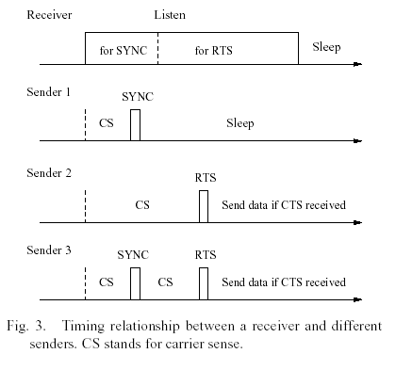
Timing Relationship

Slide 18
Collision Avoidance
Similar to IEEE 802.11 using RTS/CTS mechanism
Perform virtual and physical carrier sense before transmission
RTS/CTS addresses the hidden terminal problem
NAV –indicates how long the remaining transmission will be.

Slide 19
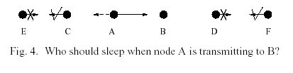
Overhearing Avoidance
Interfering nodes go to sleep after they hear the RTS or CTS packet
The medium is busy when the NAV value is not zero
All immediate neighbors of sender and receiver should go to sleep

Slide 20
Message Passing
What is a message?
Transmitting a message as a long packet
High retransmission cost
Fragmentation into small packets
High control overhead
Solution
Disadvantage

Slide 21
Protocol Implementation
Test bed
Rene motes developed at UCB
They run TinyOS, an event–driven operating system
Two types of packets
Fixed size data packets with header(6B), payload(30B) and CRC(2B)
Control packets (RTS and CTS), header(6B)
(2B) CRC

Slide 22
MAC modules implemented
Simplified IEEE 802.11 DCF – physical and virtual carrier sense, backoff and retry, RTS/CTS/DATA/ACK packet exchange and fragmentation support
Message passing with overhearing avoidance
The complete S-MAC – all the features are implemented

Slide 23
Conclusions and Future work
S-MAC has good energy conserving properties comparing to IEEE 802.11
Future work
Analytical study on the energy consumption and latency
Analyze the effect of topology changes

Slide 24
Our Project
Implementing S-MAC on TinyOS 1.0
Incorporating multicasting with S-MAC

Slide 25
Directed Diffusion and S-MAC
S-MAC can be incorporated into the directed diffusion paradigm

